Slide 1
Checkpoints Conditions Stream Analysis
By: Aladdin Odeh

Slide 2
Why Checkpoints conditions?
Checkpoints are a major issue in Palestine.
Navigating through multiple channels that report checkpoint statuses is challenging, yet essential.
Analyzing this data can reveal hidden patterns that assist in planning future trips.

Slide 3
What this project covers?
A standalone system with the following features:
A data producer that listens to multiple data sources reporting road conditions and publishes the data to the next stage.
Multiple consumers that process the raw data in real-time streams, aggregating it over a time window to generate valuable insights.

Slide 4
What this project covers?
A web app that displays the latest status, along with dashboards that extract insights about road conditions.
A predictor for road conditions, trained using the processed data.

Slide 5
Technologies:
Streaming pipeline: Spark, Kafka, Spark structured streaming written using scala.
Telegram producers: Python process that uses telegram telethon lib.
Mongo db for storage.
Node js API to query aggegated data from mongo db.
React web app to visualize all functioninalites
Python api for checkpoint status prediction.

Slide 6
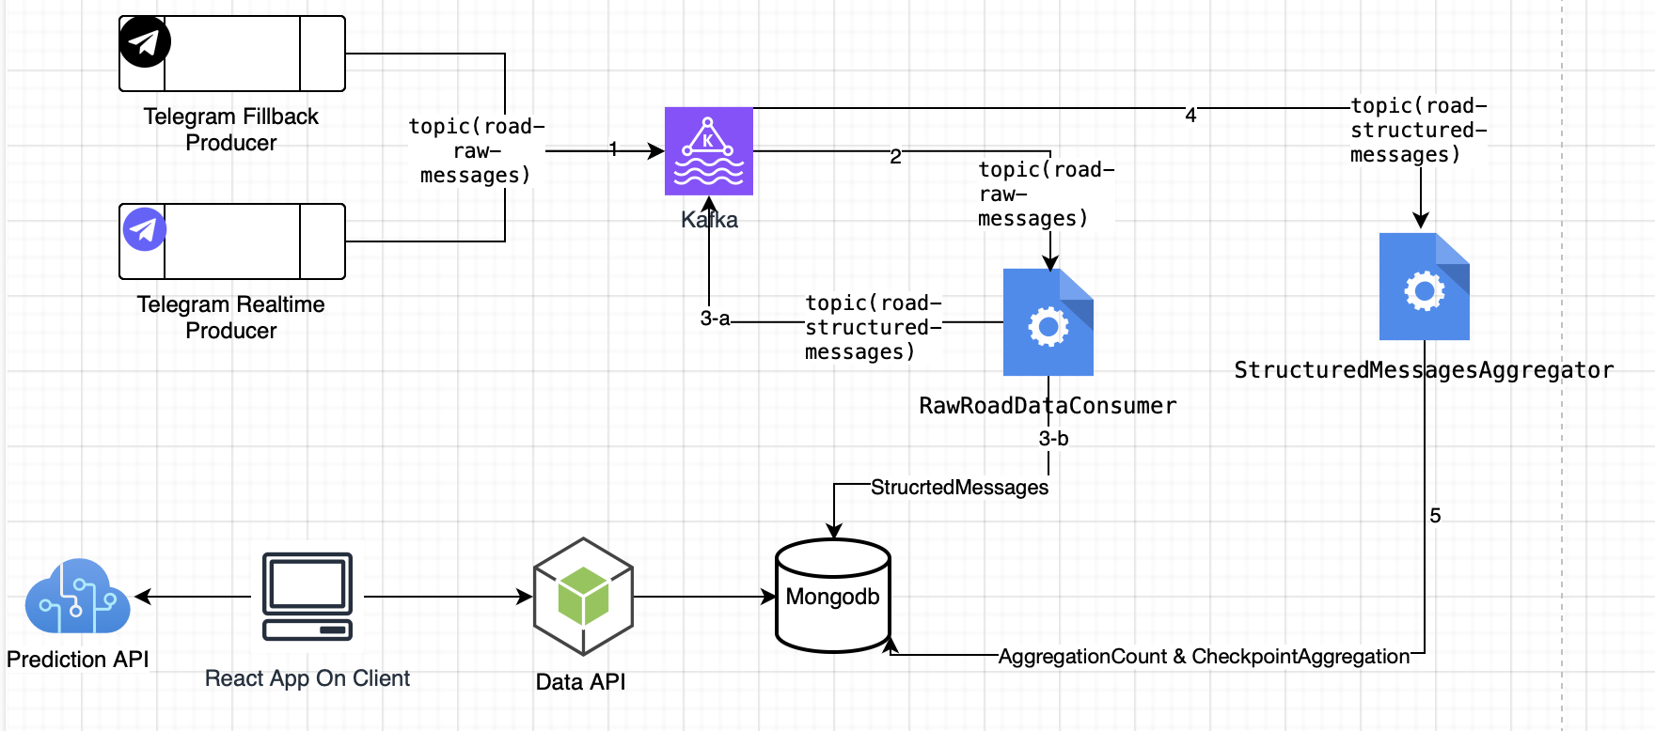
System Design:

Slide 7
Producer
There are 2 data producers that use Telegram api client (telethon):
1- A real-time producer which fetches the recent messages every couple of seconds.
2- A fill back producer which can fetch, sync, populate data for x days lookback period.

Slide 8
Spark structured streaming kafka consumers:
Raw Messages consumer:
It takes messages from producer, filter out duplicate message, process the messages and push them to the next consumer, and to mongodb.
Structured Messages consumer:
It makes a real-time aggregations over a window of 1 hour for the structured data and save it in mongodb

Slide 9
Challenges:
Telegram API limitations.
Jar bundling and submitting.
Defining the requirments of the product.

Slide 10
Duplication Handling:
A bloom filter was used to handle duplicate messages.
  This proved to be very handy with the Telegram API limitations, which can cause duplicate messages in some cases. Additionally, it allows for some overlap between the real-time messaging service and the fallback service.

Slide 11
Why two consumers:
Decoupling: One consumer focuses on processing raw data (validation, enrichment), while the other specializes in aggregating processed data for reporting which simplifies debugging and scaling.
Enhanced Fault Tolerance: If one consumer fails, the other can continue functioning. For instance, processing can proceed even if aggregation faces issues, and vice versa.
Specialized Processing: Processing consumer can focus on transforming individual records, while the aggregation consumer can work on batch processing, grouping, and summarizing records.
Flexibility for Consumers: Other systems can consume data from either the processing topic (for real-time needs) or the aggregation topic (for summarized insights) without interfering with each other.

Slide 12
The prediction model
With this amount of structured data, it becomes irresistible to experiment with a transformer model to predict future checkpoint conditions.
The model primarily relies on cyclic features (such as the day of the week and the hour of the day) to predict checkpoint status.
A voting classifier was trained, achieving an overall accuracy of 80%, with significant potential for improvement.

Slide 13
Demo

